Slide 1

PROJECT
COURSE
EE299 - 2025
Project Supervisor:
Prof. Uttama Lahiri
Presented by:
Arnav Jagtap

Slide 2






Table of Contents
01.
Introduction
05.
Conclusion and Future Scope
02.
Description (What?)
06.
Result and Demonstration
03.
Objectives (Why?)
07.
Reference
04.
Methodology (How?)
08.
Closing and Q&A

Slide 3
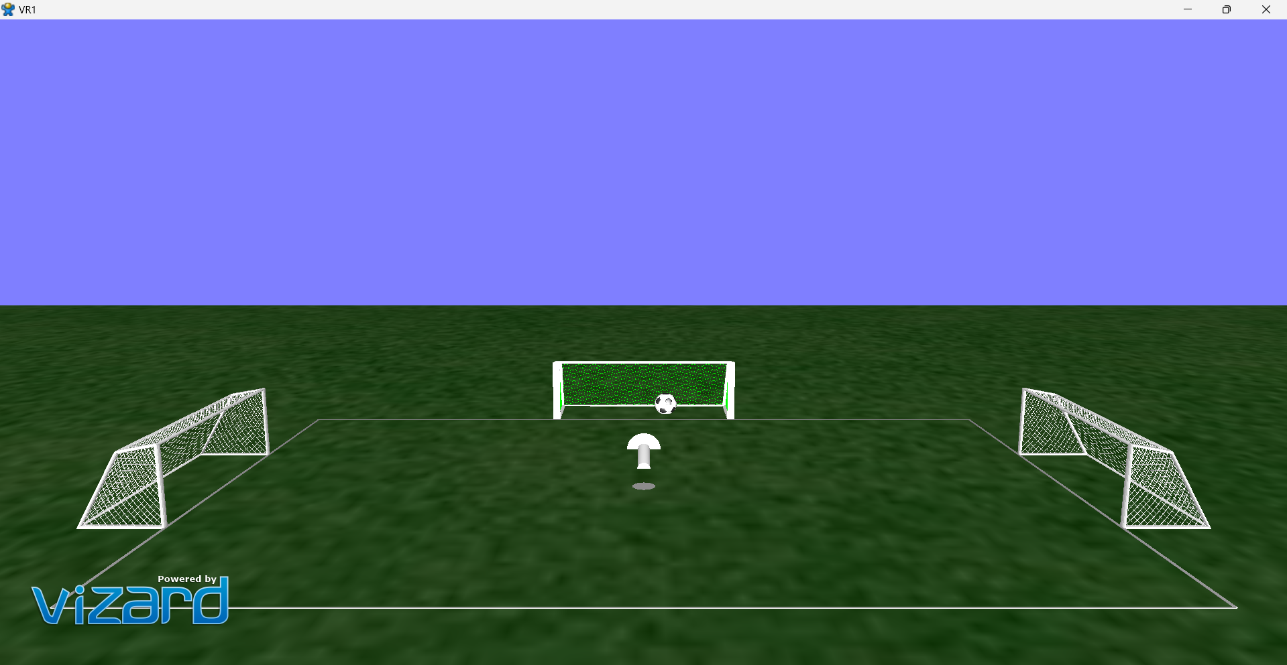
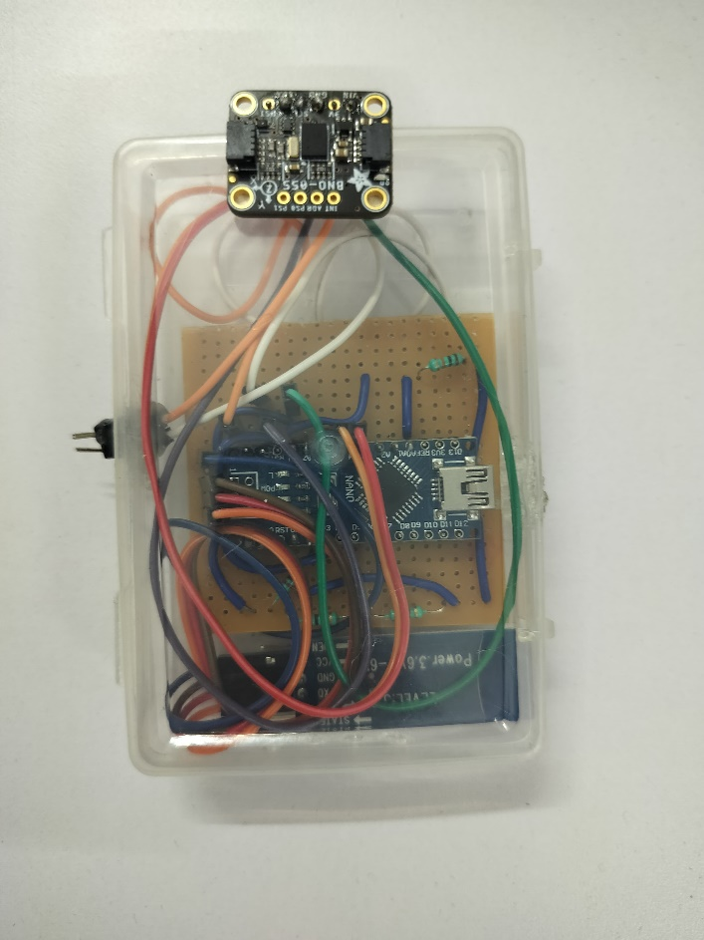
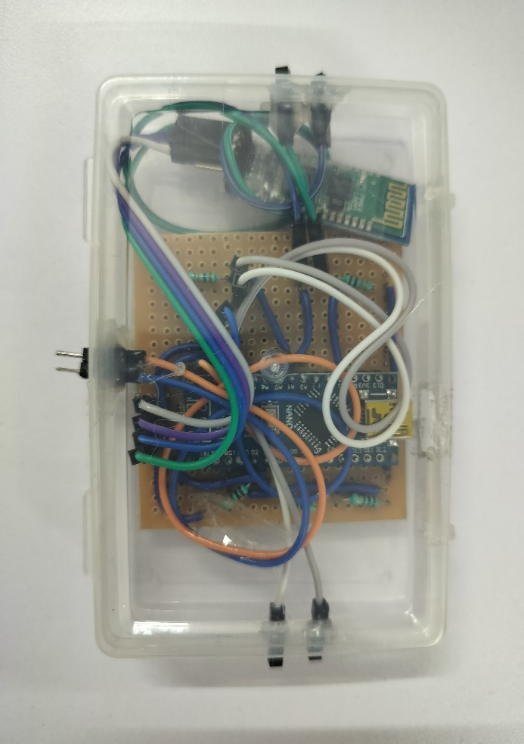
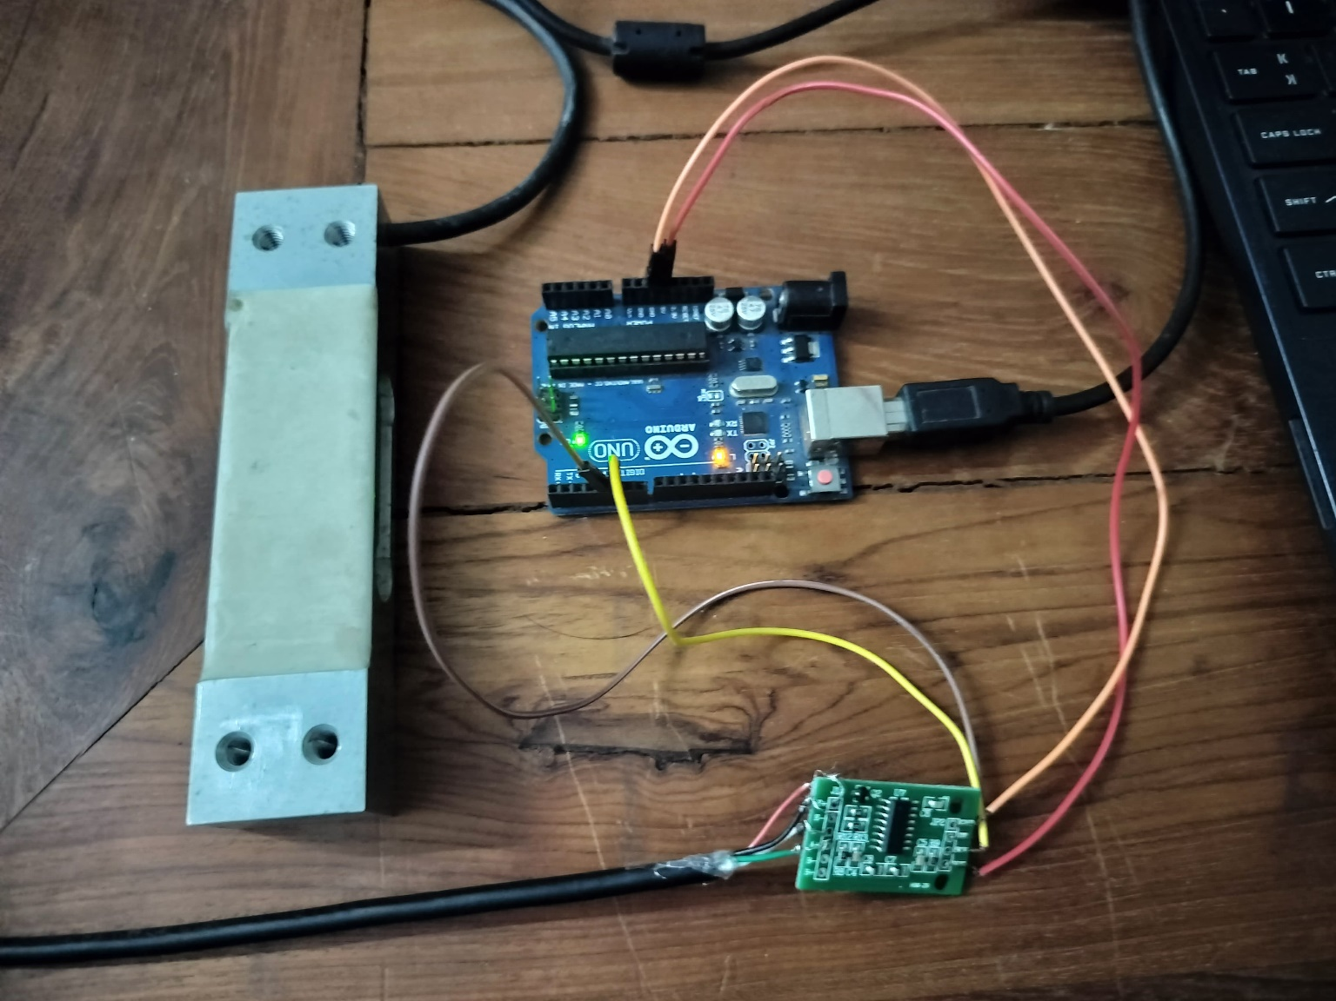
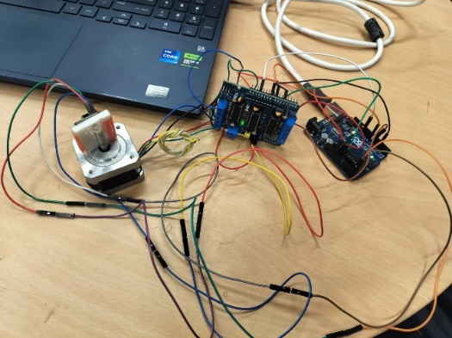
Introduction
Project Overview
This project is part of a research initiative titled "Muscle Synergy Assessment During Postural Tasks in Rehabilitation Patients Using Balance Board and EMG Signals."
The primary objective is to investigate how muscle groups coordinate during balance-related activities, particularly in individuals undergoing physical rehabilitation.
We are developing a game-based postural task system to analyze lower body muscle synergies in rehabilitation patients. This approach makes the task engaging while still collecting meaningful neuromuscular data.

Slide 4
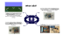
Table of Contents
01.
Introduction
05.
Conclusion and Future Scope
02.
Description (What?)
06.
Result and Demonstration
03.
Objectives (Why?)
07.
Reference
04.
Methodology (How?)
08.
Closing and Q&A

Slide 5



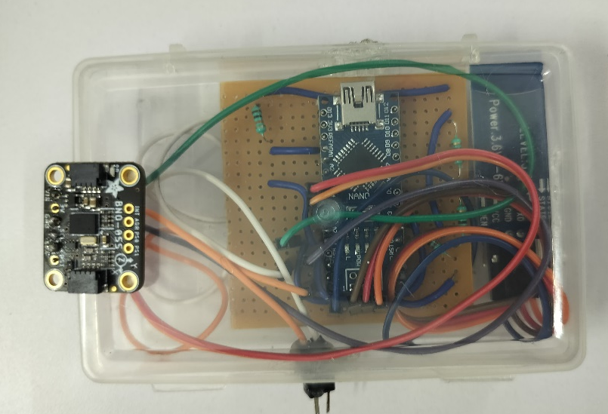

What I did?
A smart wireless system developed for the real-time detection and monitoring of leg lift movements using sensor-based feedback.
Designed and implemented virtual environment game to assess lower body muscle synergies during balance-related tasks in rehabilitation settings.
01
02
A smart wireless system designed for real-time detection and monitoring of human posture using sensor-based feedback.
03
04
Calibration of the Load Cell and IMU sensor

Slide 6
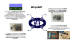
Table of Contents
01.
Introduction
05.
Conclusion and Future Scope
02.
Description (What?)
06.
Result and Demonstration
03.
Objectives (Why?)
07.
Reference
04.
Methodology (How?)
08.
Closing and Q&A

Slide 7


Why I did?
To detect incorrect posture or leg lift during balance-based tasks by using FSR sensors, which trigger a buzzer when a user’s foot unintentionally lifts off the balance board
To provide an engaging and interactive method for evaluating motor coordination and muscle activation patterns in patients undergoing physical rehabilitation, with the goal of improving assessment accuracy and patient participation.
01
02
To ensure accurate and reliable measurements of force and body orientation by aligning sensor outputs with known reference values
03
04
To detect and monitor the user's body inclination during balance-related tasks using an IMU sensor, which measures real-time posture angles and provides feedback.

Slide 8
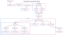
Table of Contents
01.
Introduction
05.
Conclusion and Future Scope
02.
Description (What?)
06.
Result and Demonstration
03.
Objectives (Why?)
07.
Reference
04.
Methodology (How?)
08.
Closing and Q&A

Slide 9
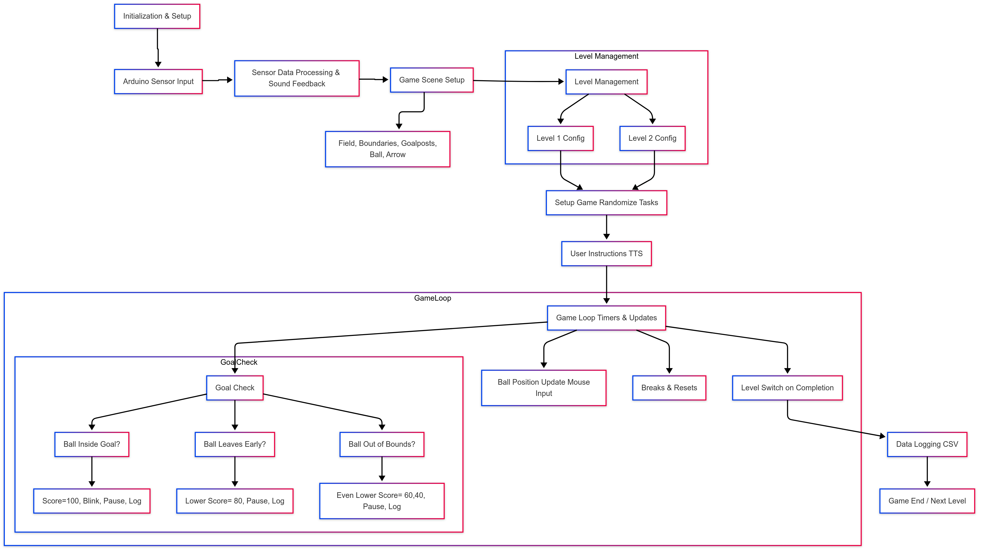
1. Virtual Environment Game

Slide 10
check_sensor_data() :
Monitors the Arduino sensor data and plays a sound if both legs are lifted.
speak_text():
Uses TTS to speak the specified text.
changeToGreen():
Changes the color of the red box to green.
makeInvisible():
Hides the red box and triggers goal instructions after a small delay.
speakGoalInstruction():
Provides instructions to the player about following the arrow and staying in the goal area.
initializeGame():
Randomly selects an initial game level.
setupLevel(level):
Sets up the game environment based on the chosen level.
setupGame():
Randomizes the order of tasks (goal positions).
checkGoal():
Core function to check the ball's position in relation to the goals and maintain game state. It manages scoring and logs gameplay data.
If ball is inside the goal then 100 points and if ball is outside then 60 points.
updateBallPosition():
Updates the ball's position based on mouse input, while ensuring that movement is disabled during breaks.
startBreak():
Initiates a brief break, resets the ball position, and pauses the game.
pauseBallInGoal():
Pauses the ball in the goal area after scoring.
resetBallPosition():
Resets the ball's position to the center of the field and disables movement.
switchToLevel1():
Switches back to Level 1, making the respective game objects visible, while hiding Level 2 objects.
switchToLevel2():
Changes the game to Level 2 by hiding Level 1 objects and showing Level 2 objects.
setupLevel2():
Configures the game environment also incorporating larger goalposts and boundaries for Level 2 play.

Slide 11
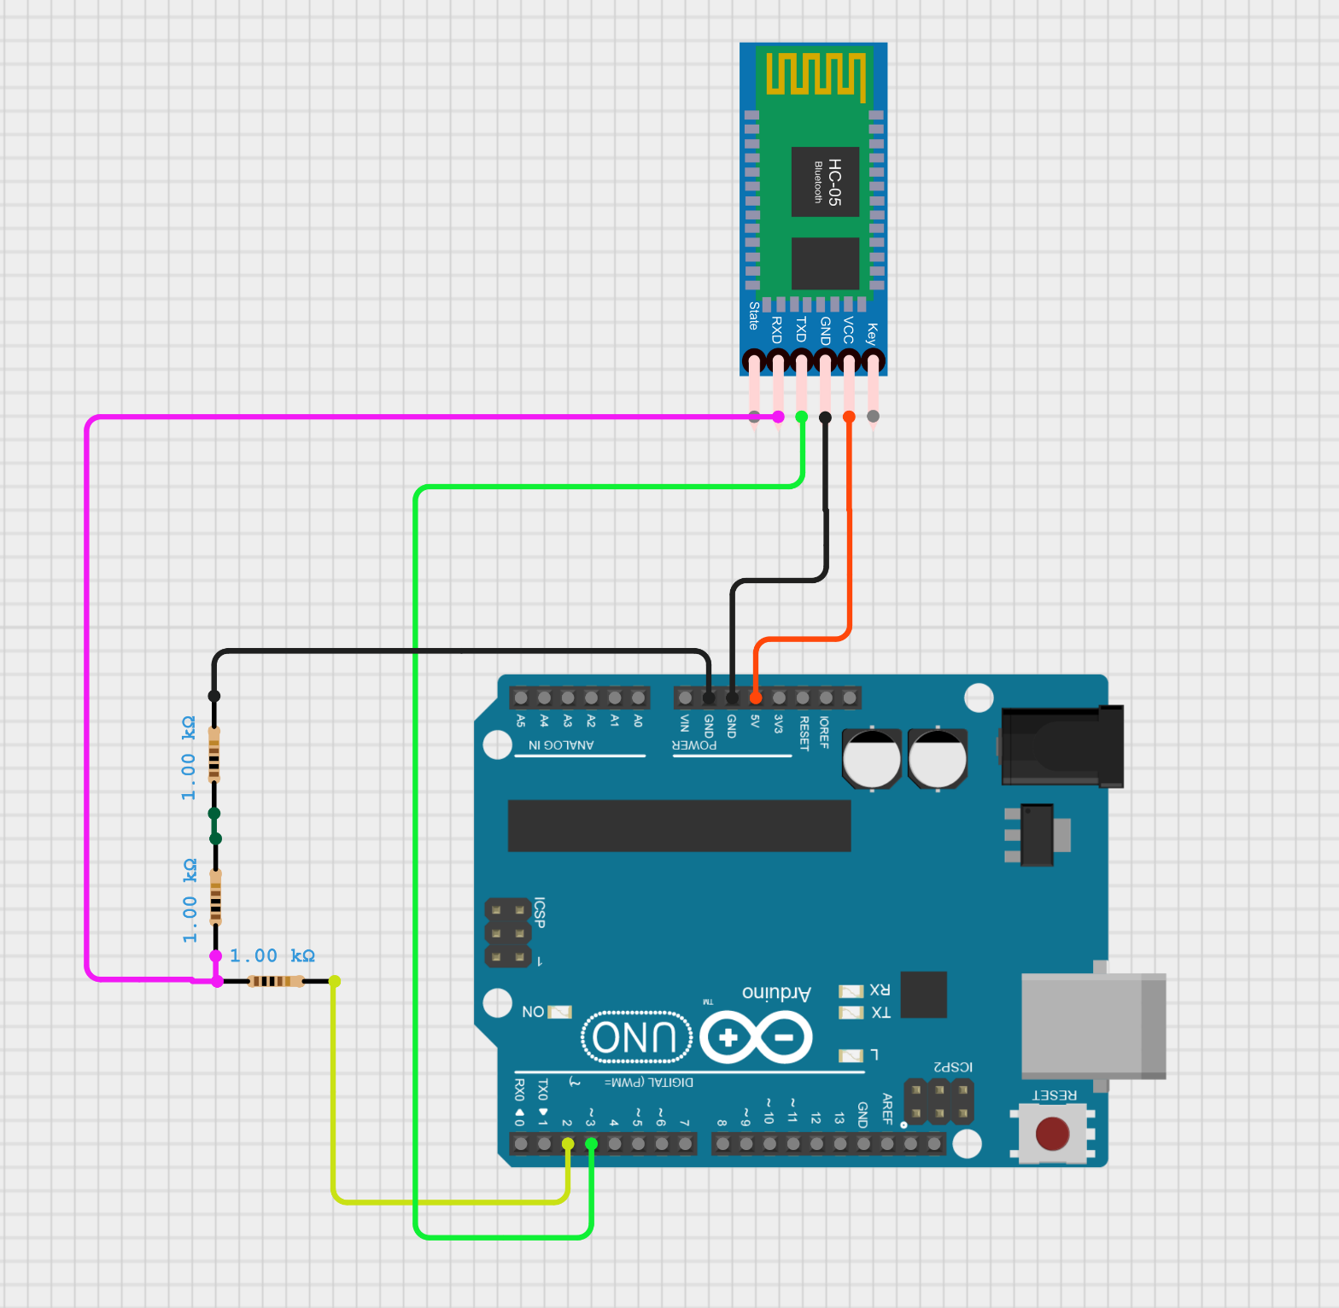
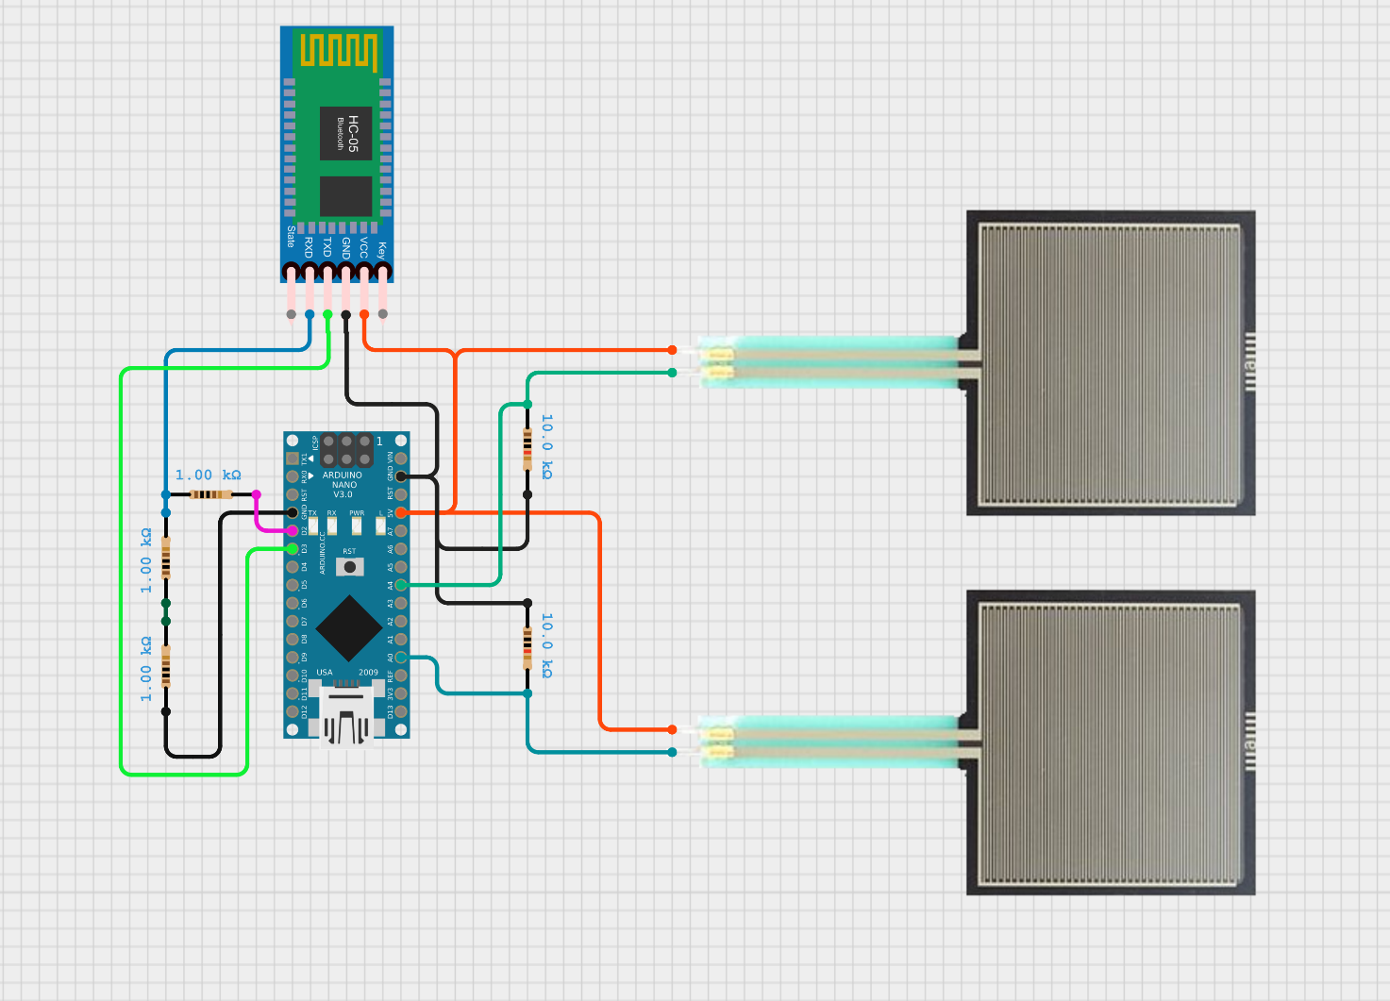
2. Wireless Leg Lift Detection System
Receiver
Sender

Slide 12
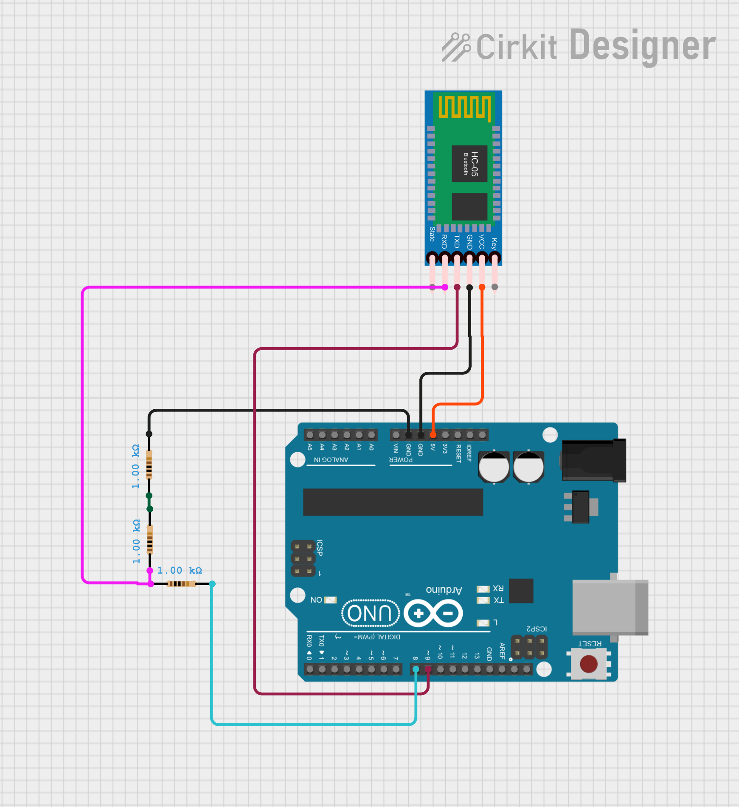
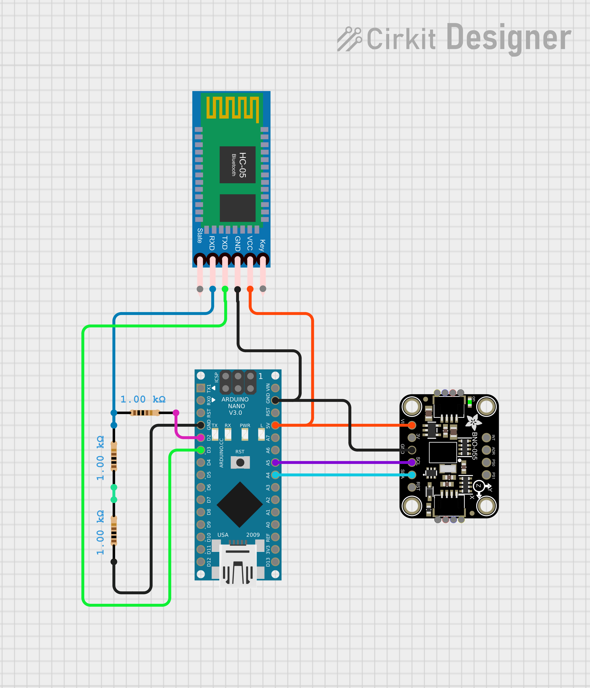
3. Wireless Posture Measurement System
Receiver
Sender

Slide 13
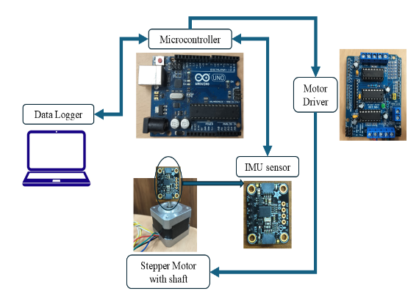
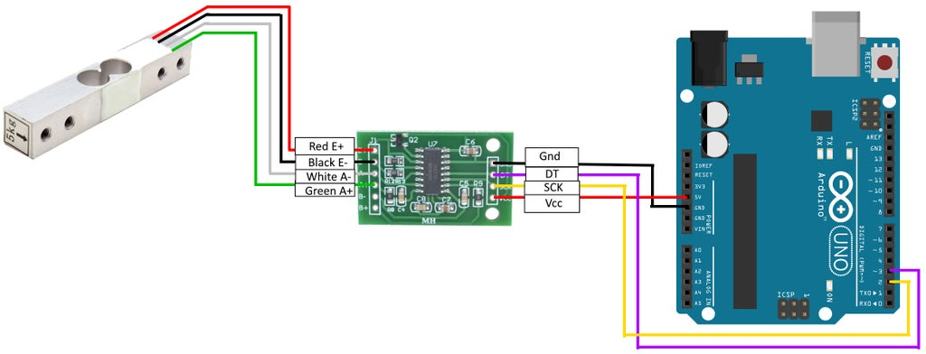
4. Calibration of the Load cell and IMU sensor

Slide 14
Table of Contents
01.
Introduction
05.
Conclusion and Future Scope
02.
Description (What?)
06.
Result and Demonstration
03.
Objectives (Why?)
07.
Reference
04.
Methodology (How?)
08.
Closing and Q&A

Slide 15

Conclusion and Future Scope
Conclusion
Future Scope
All the individual systems were successfully integrated into a combined setup for acquiring muscle synergy data. The system effectively detects leg lifts and measures posture in real-time.
I encountered several challenges while designing the circuits and developing the virtual environment, but these experiences significantly contributed to my learning and problem-solving skills.
In the future, the posture measurement system can be extended to full-body movement analysis. This would allow for mapping complete body movements within the virtual environment, enabling more immersive assessment.
This system can also be utilized as a balance training tool to enhance motor abilities in post-stroke patients, aiding in their rehabilitation process through interactive and engaging feedback.

Slide 16
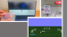
Table of Contents
01.
Introduction
05.
Conclusion and Future work
02.
Description (What?)
06.
Result and Demonstration
03.
Objectives (Why?)
07.
Reference
04.
Methodology (How?)
08.
Closing and Q&A

Slide 17
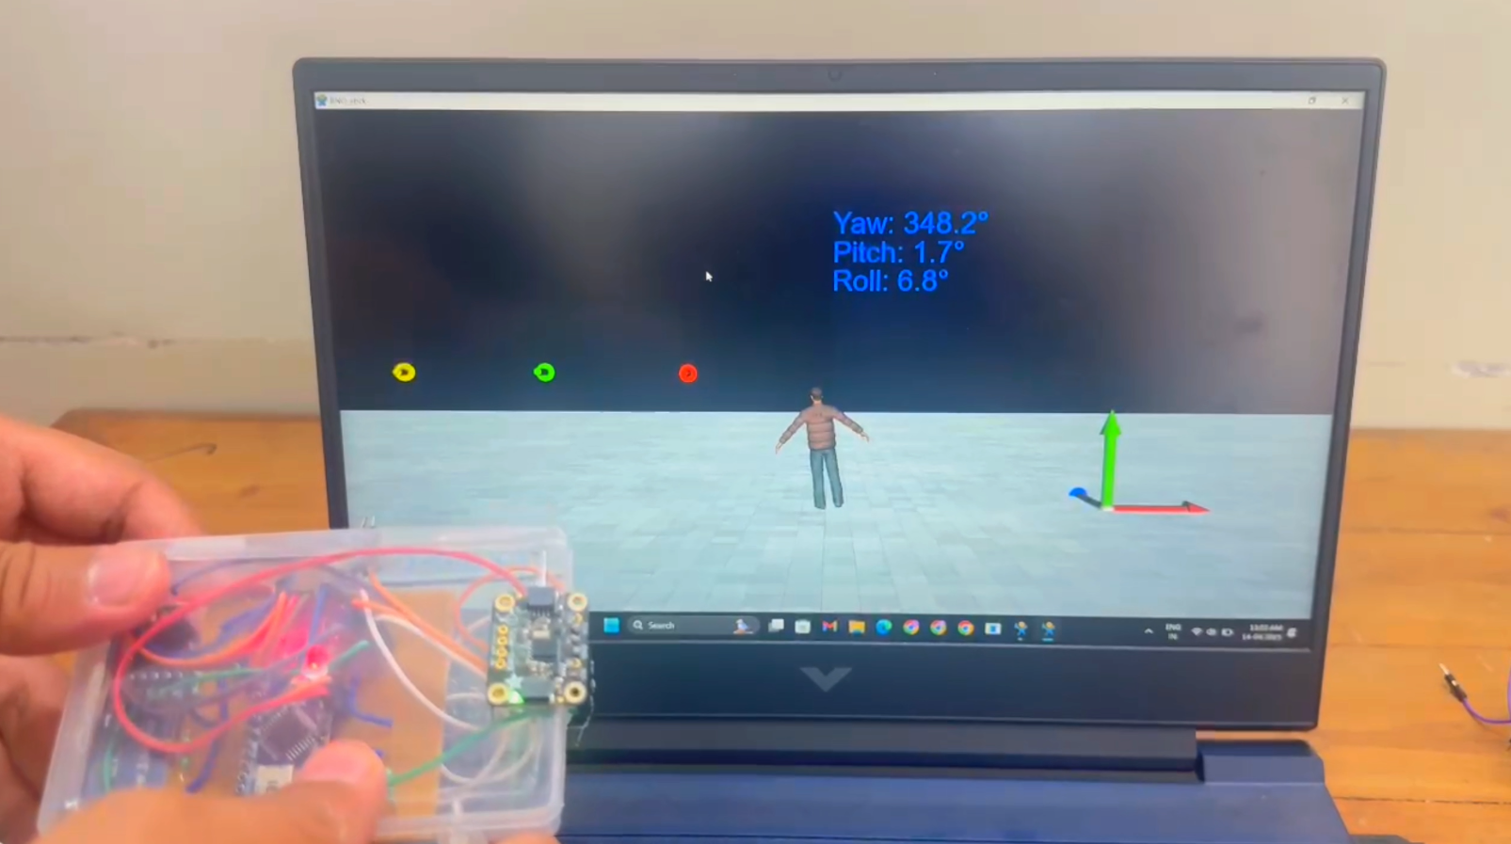
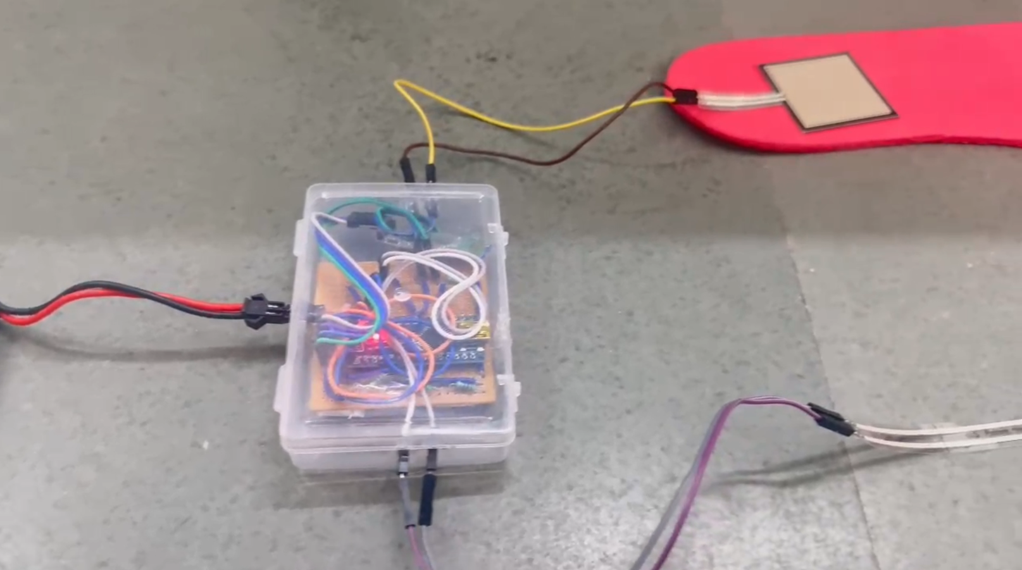
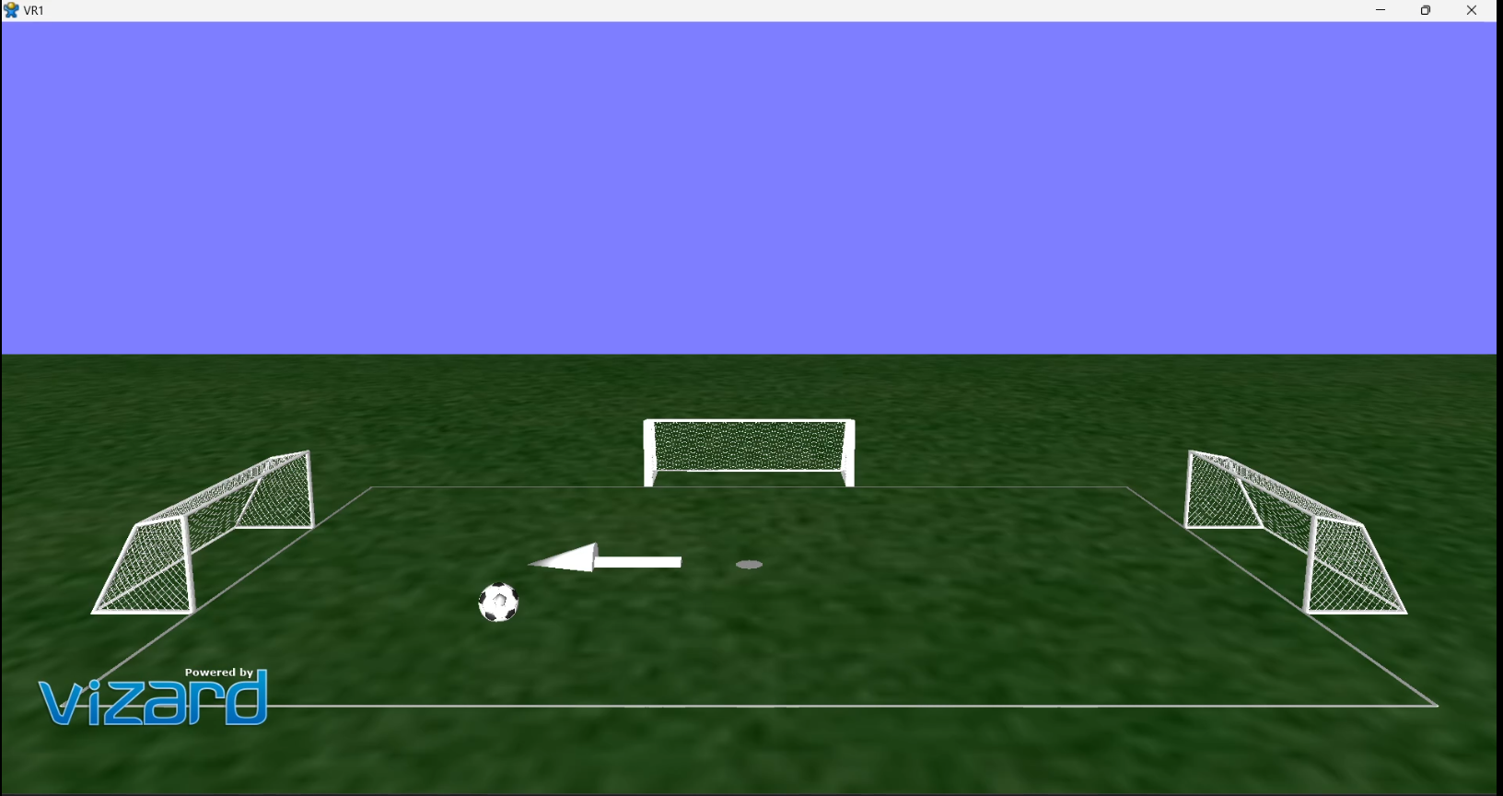

Slide 18

Table of Contents
01.
Introduction
05.
Conclusion and Future work
02.
Description (What?)
06.
Result and Demonstration
03.
Objectives (Why?)
07.
Reference
04.
Methodology (How?)
08.
Closing and Q&A

Slide 19
References
[1] A. Kumar and B. Smith, "A novel rehabilitation method," IEEE Trans. Neural Syst. Rehabil. Eng., vol. 28, no. 12, pp. 1250–1260, Dec. 2020.
[2] "How to Configure HC-05 Bluetooth Module As Master," Instructables. [Online]. Available: https://www.instructables.com/How-to-Configure-HC-05-Bluetooth-Module-As-Master/. [Accessed: 16-Apr-2025].
[3] WorldViz, "Vizard Documentation," [Online]. Available: https://docs.worldviz.com/vizard/latest/. [Accessed: 16-Apr-2025].
[4] Tekscan, "The Differences Between Force Sensitive Resistor Technologies: Assessing Linearity, Drift, and Other Performance Factors," [Online]. Available: https://www.tekscan.com/blog/flexiforce/differences-between-force-sensitive-resistor-technologies-assessing-linearity-drift. [Accessed: 16-Apr-2025].
[5] Bosch Sensortec, "BNO055: Intelligent 9-axis absolute orientation sensor, data sheet," Revision 1.2, Nov. 2014. [Online]. Available: https://cdn-shop.adafruit.com/datasheets/BST_BNO055_DS000_12.pdf. [Accessed: 16-Apr-2025].
[6] ADI Artech, "60710 Platform Scale Loadcell Datasheet," [Online]. Available: https://seegateloadcell.com/wp-content/uploads/2021/02/60710-loadcell-1.pdf. [Accessed: 16-Apr-2025].

Slide 20

Table of Contents
01.
Introduction
05.
Conclusion and Future work
02.
Description (What?)
06.
Result and Demonstration
03.
Objectives (Why?)
07.
Reference
04.
Methodology (How?)
08.
Closing and Q&A

Slide 21
Thank You
For Your Attention
I would like to sincerely thank the members of the IRACS Lab for their invaluable support and knowledge throughout this work. A special note of thanks to Mr. Somen Sarkar for his continuous guidance, and to Prof. Uttama Lahiri for her mentorship and inspiration.

